Slide 1
What will you do with Watson?
Research Bazaar, 2016
Shaila Pervin
Postdoctoral Researcher
IBM Research Australia
Wanita Sherchan
Research Scientist
IBM Research Australia

Slide 2
Agenda
Introduction to Watson
Watson Services Available in Bluemix
Sample Applications
Deep Dive on Personality Insights Service

Slide 3
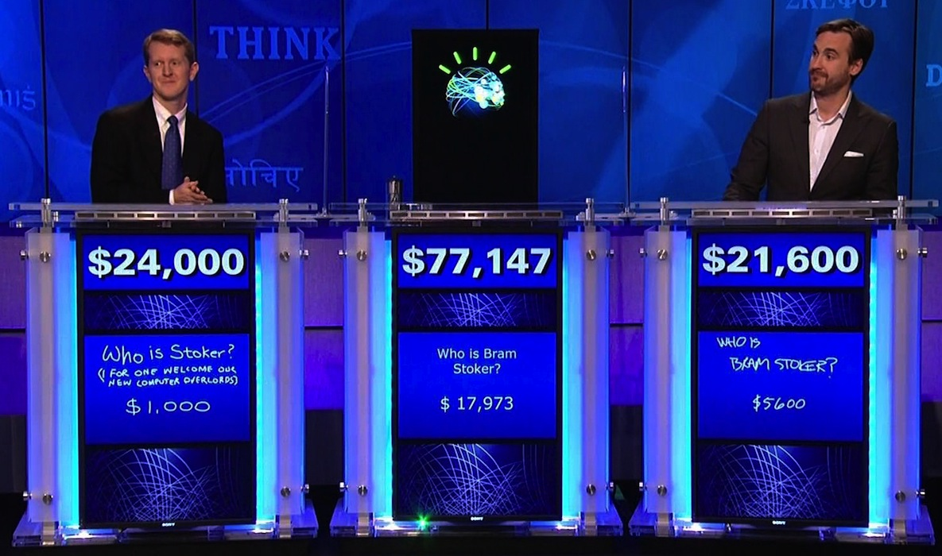
What is Watson?
On February 14, 2011, IBM Watson changed history introducing a system that rivaled a human’s ability to answer questions posed in natural language with speed, accuracy and confidence.

Slide 4


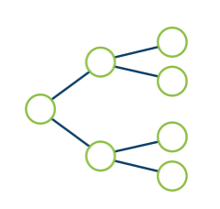
What Watson can do for you?
IBM Watson is a technology platform that uses natural language processing and machine learning to reveal insights from large amounts of unstructured data.
Answer customers' most pressing questions
Quickly extract key information from all documents
Reveal insights, patterns and relationships across data

Slide 5

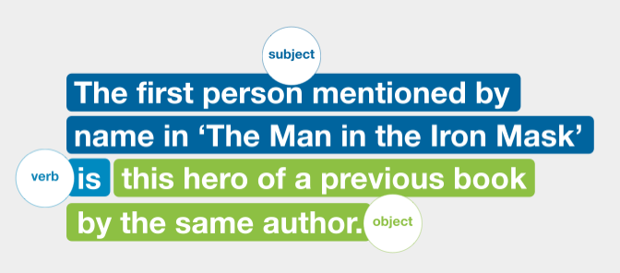
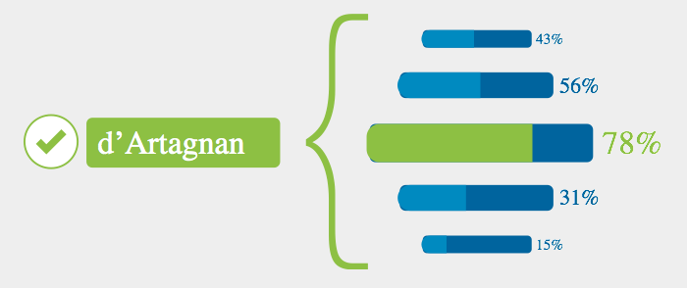
How Watson reveals insights?
Analyzes unstructured data
Uses natural language processing to understand grammar and context
Understands complex questions
Evaluates all possible meanings and determines what is being asked
Presents answers and solutions
Based on supporting evidence and quality of information found

Slide 6
Agenda
Introduction to Watson
Watson Services Available in Bluemix
Sample applications
Deep Dive on Personality Insights Service

Slide 7
IBM Watson Developer Cloud
The Watson Developer Cloud is a library of Watson APIs that you can use to create Powered by Watson apps.
Language
AlchemyLanguage
Concept Expansion
Concept Insights
Dialog
Document Conversion
Language Translation
Natural Language Classifier
Personality Insights
Relationship Extraction
Retrieve and Rank
Tone Analyzer
Speech
Speech to Text
Text to Speech
Vision
AlchemyVision
Visual Insights
Visual Recognition
Data Insights
AlchemyData News
Tradeoff Analytics

Slide 8
Agenda
Introduction to Watson
Watson Services Available in Bluemix
Sample Applications
Deep Dive on Personality Insights Service

Slide 9
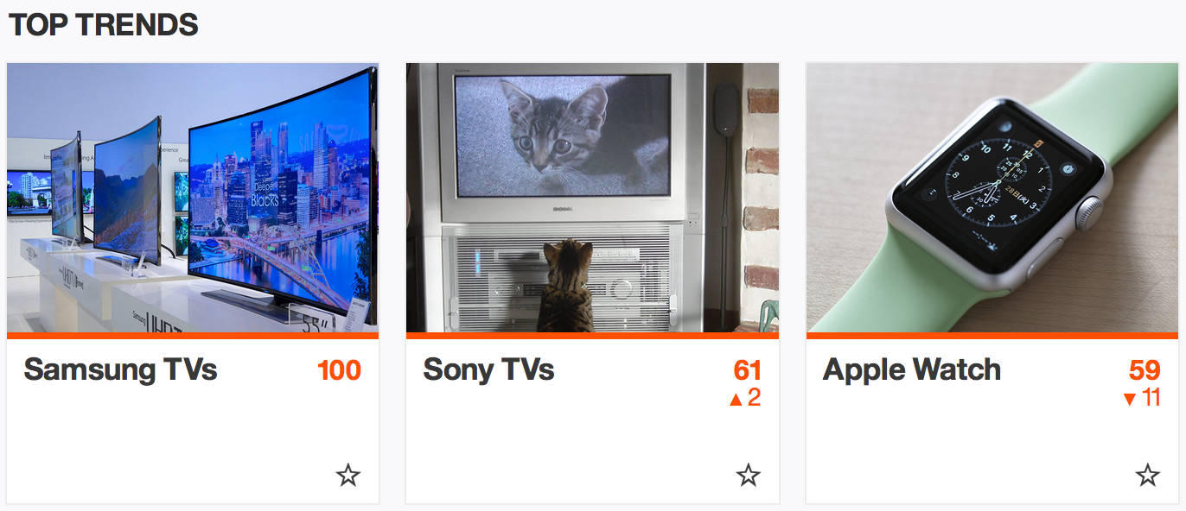
Watson Trend
What it does
Watson Trend helps shoppers understand what is trending and why through the cognitive power of Watson.
Link
https://ibmwatsontrend.com/
Watson service
Retrieve and Rank
Tone Analyzer
Speech to Text
Text to Speech

Slide 10
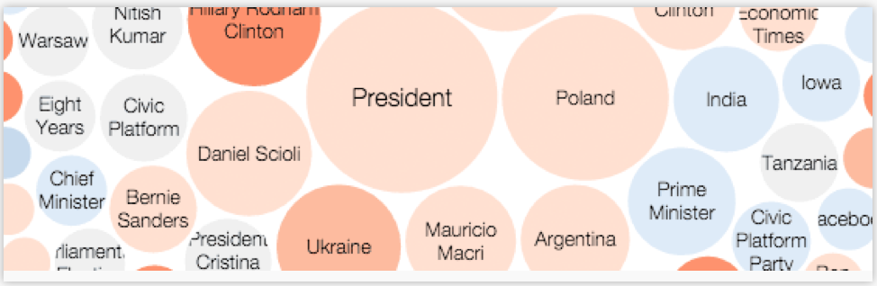
Election Insights
What it does
Performs natural language processing on 75,000+ news sources as they are published and uses Alchemy's taxonomy breakdown to focus on all things election.
Link
http://electioninsights.mybluemix.net/
Watson service
AlchemyData News

Slide 11

What's In Theaters
What it does
Allow users to converse with Watson in order to search for current or upcoming movies using the 'themoviedb.org' database.
Link
watson-movieapp-dialog.mybluemix.net/watson-movieapp-dialog/dist/
Watson service
Dialog
Natural Language Classifier

Slide 12

Watson Rover
What it does
A Rover that autonomously navigates a maze by interpreting multi-lingual instructions and recognising visual cues
Link
https://vimeo.com/ibmwatson/review/130135196/ededb6b90f
Watson service
Speech to Text
Visual Recognition

Slide 13

SF Life
What it does
Find the best area to live in San Francisco based on lifestyle preferences.
Link
http://san-francisco-life.mybluemix.net/
Watson service
Tradeoff Analytics

Slide 14
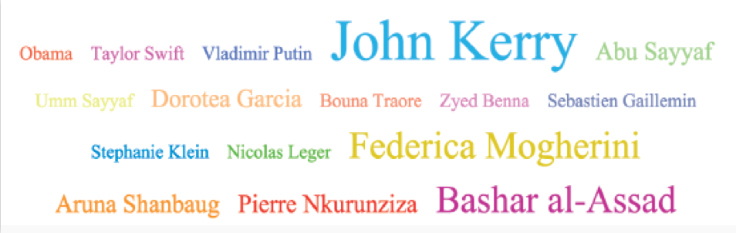
People in the News
What it does
See who is trending in the news on an hourly basis.
Link
http://pitn.mybluemix.net/
Watson service
Relationship Extraction

Slide 15
Agenda
Introduction to Watson
Watson Services Available in Bluemix
Sample applications
Deep Dive on Personality Insights service

Slide 16


What is Personality Insights?
Linguistic analytics from digital communications like email, text messages, tweets, and forum posts
Extracts and analyzes a spectrum of personality attributes
actionable insights about people and entities
highly personalized interactions
Inference of individuals' intrinsic personality characteristics

Slide 17
The science behind Personality Insights
Big Five
How a person engages with the world
Openness
Conscientiousness
Extraversion
Agreeableness
Neuroticism
Needs
Which aspects of a product are likely to resonate with the author of the text ¹
Values
Motivating factors that influence the author's decision-making ²
¹ 12 categories of needs based on Kotler's and Ford's work in marketing
² 5 dimensions of human values based on Schwartz's work in psychology

Slide 18

How does Personality Insights work?
Human language
personality
thinking style
social connections
emotional states
Notes:
human language reflects personality, thinking style, social connections, and emotional states.
frequency with which we use certain categories of words can provide clues to personality, thinking style, social connections, and emotional stress

Slide 19
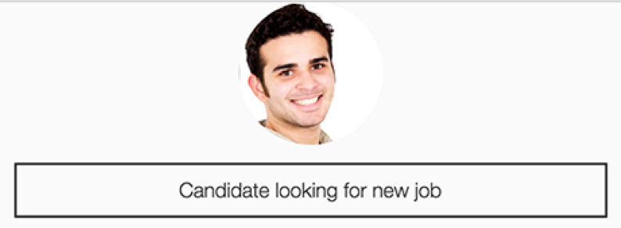
Application: Cognitive Head Hunter
What it does
Helps a candidate find the next job position.
Link
http://chh.mybluemix.net/
Watson service
Concept Insights
Personality Insights

Slide 20

Application: Designer Match
What it does
Helps you find accessories by matching designer personalities.
Link
http://roztayger.com/match/designer
Watson service
Personality Insights

Slide 21
More information on Personality Insights
Science behind the service
https://www.ibm.com/smarterplanet/us/en/ibmwatson/developercloud/doc/personality-insights/science.shtml
More applications
http://www.ibm.com/smarterplanet/us/en/ibmwatson/developercloud/gallery.html
Demo
https://watson-pi-demo.mybluemix.net/

Slide 22
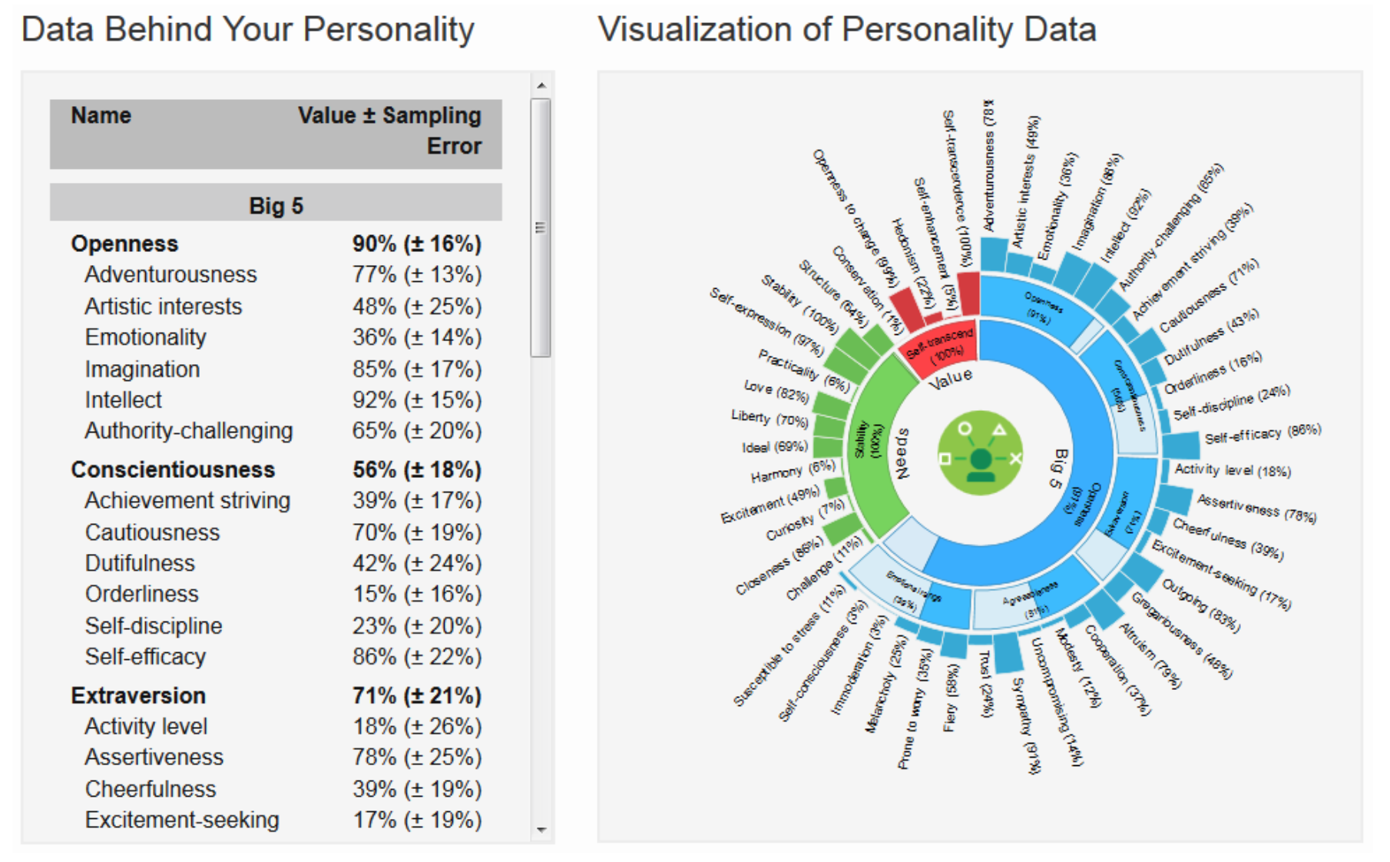
How to use Personality Insights
Input
JSON, or Text or HTML written by one individual containing words about every day experiences, thoughts, and responses
3500+ words
Output
A tree of cognitive and social characteristics in JSON or CSV format

Slide 23

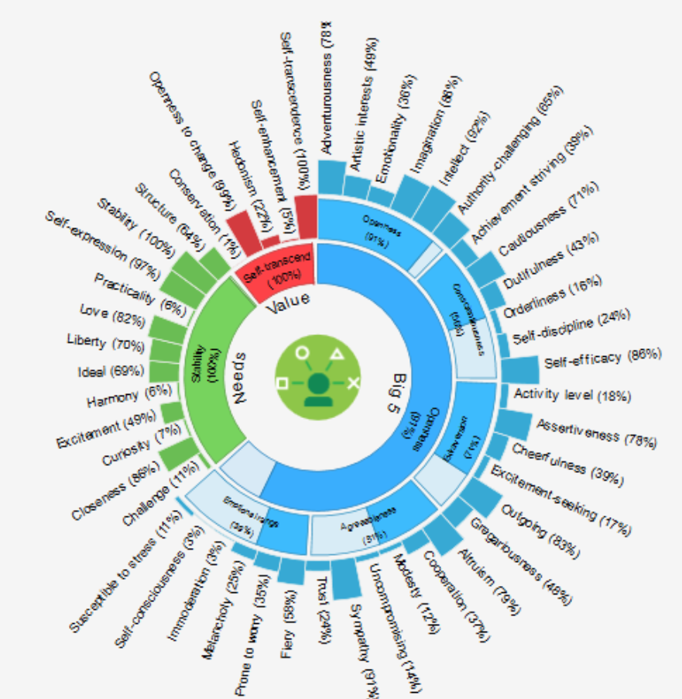



Personality Insights using Twitter data
Demo link: https://watson-pi-demo.mybluemix.net/
1. Receives Twitter handle
Tweet Collection Module
2. Collects recent
300 tweets
3. Provides
Input text
Personality
Insights
4. Generates
Personality
information
External
Twitter API
IBM Bluemix

Slide 24
Twitter Personality Insights Demo – Hands on
Download code from
https://mrlgit.au.ibm.com/wanita/tweet-extractor-rte
Install cloud foundry command line tool
https://github.com/cloudfoundry/cli#downloads
Update Twitter credentials (optional)
Compile the code
Run it in Bluemix
cd your_new_directory/target directory
cf api https://api.ng.bluemix.net
cf login -u your_IBM_id –o your_org_name -s your_space
cf push app_name –b java_buildpack –p appWarName

Slide 25
Q&A

